Slide 1

CONNECTTEL
Jackline Inkebil

Slide 2


Introduction
ConnectTel
A leading telecommunications company at the forefront of innovation and connectivity solutions.
Services offered includes;
mobile networks
broadband connections
enterprise solutions
Problem;
loss of valuable customers to competitors.
Possible Outcome;
To accurately forecast customer churn and implement targeted retention initiatives

Slide 3

EDA

Slide 4
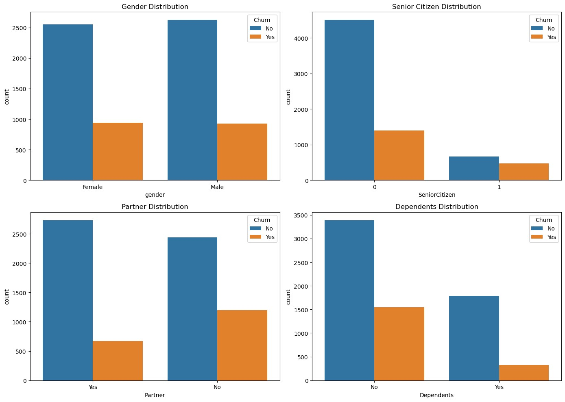
Customer Churn By Customer Segmentation

Slide 5
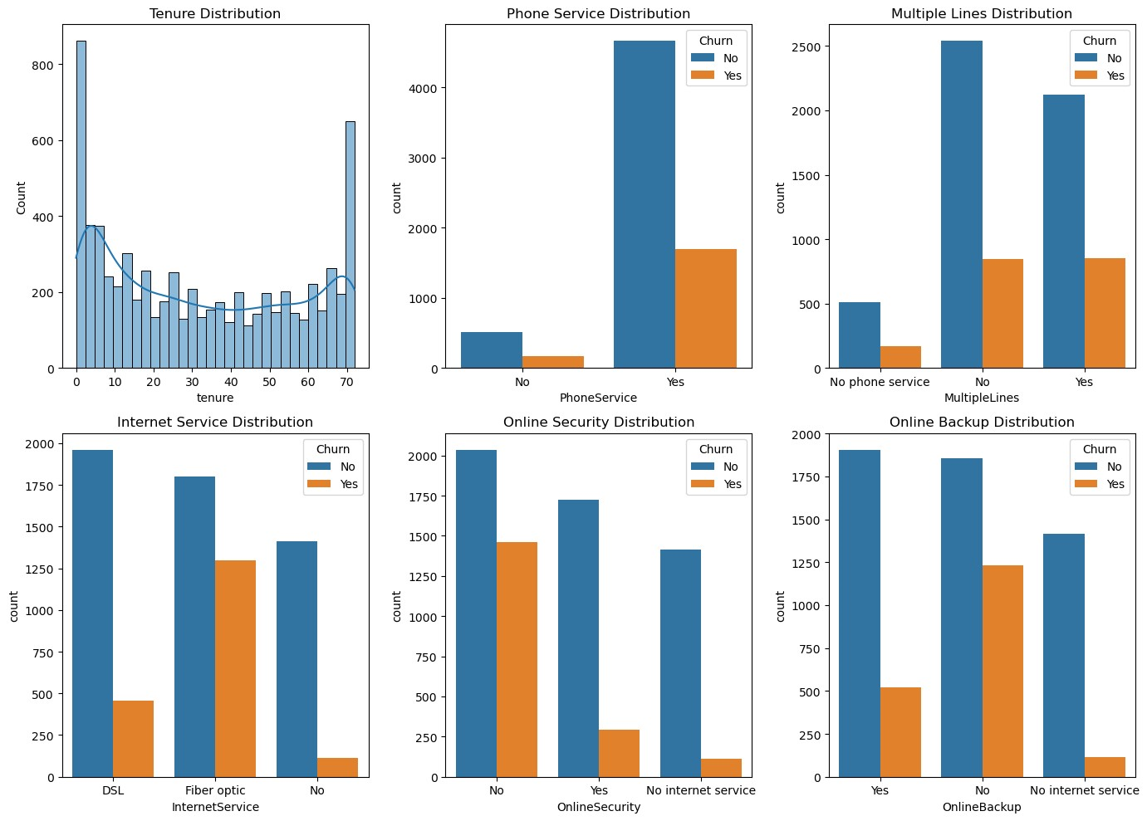
Customer Churn By Company services

Slide 6

Machine Learning Model Implementation
Logistic Regression Model
RandomForest Regression
XGB Classifier

Slide 7
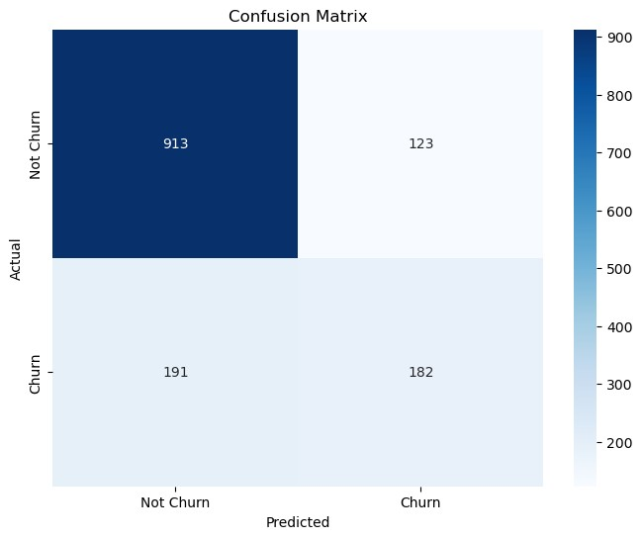
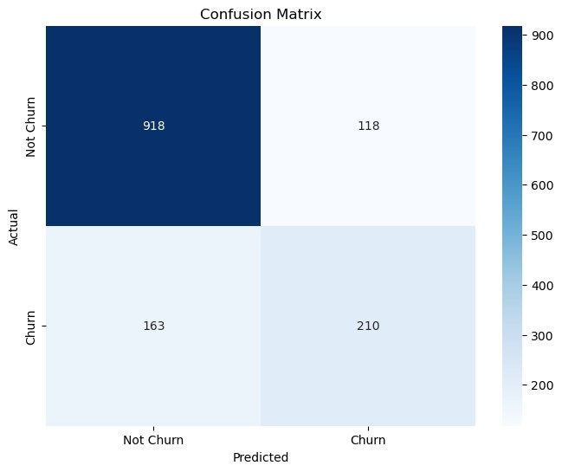
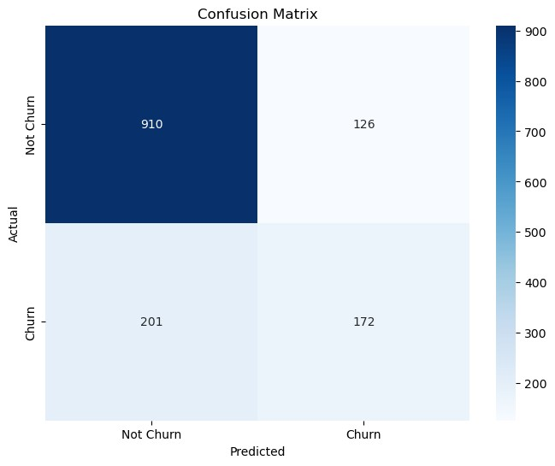
Customer Churn Prediction
Random Forest
Logistic Regression
XGB Classifier

Slide 8



Conclusion:
Summary: In conclusion, the analysis provided valuable insights into customer churn.
Recommendations: "Based on these findings, the implementation of customer targeted marketing initiatives are recommended
Next Steps; Other Machine Learning Models to be used and the selected Model’s performance to be improved.

Slide 9


THANK YOU

